Slide 1


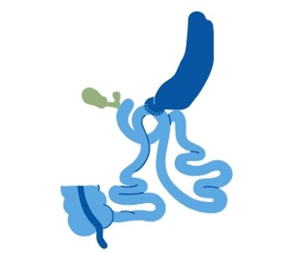
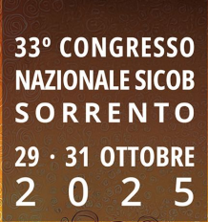
One-Stage vs. Two-Step One Anastomosis Duodenal Switch (OADS/SADI-S)
Javier Osorio, MD, PhD
30th October 2025
Notes:
Buenos días, compañeros. En la sesión de hoy queremos hablaros de la cirugía bariátrica hipoabsortiva primaria .

Slide 2
One-Stage vs. Two-Step One Anastomosis Duodenal Switch (OADS/SADI-S)
SADI-S as revisional technique after GV Vs. DS 2nd step Vs. SADI-S 1 step Time free from obesity Take-home messages
Notes:
Buenos días, compañeros. En la sesión de hoy queremos hablaros de la cirugía bariátrica hipoabsortiva primaria .

Slide 3
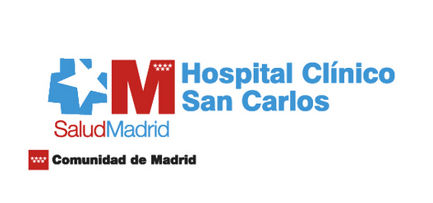
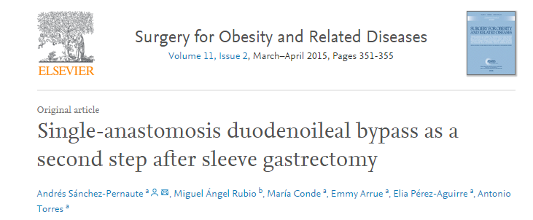
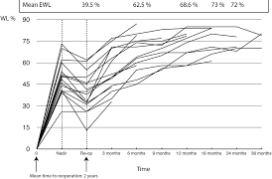
n = 16
Initial BMI = 56 kg/m2
EWL 72% / 2 years

Slide 4

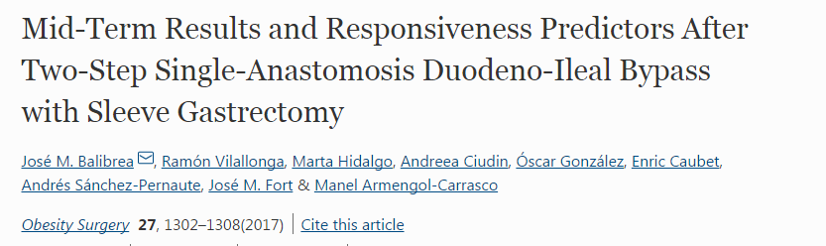
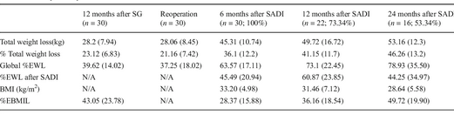
n = 30
Initial BMI = 40 kg/m2
EWL 79% / 2 years

Slide 5

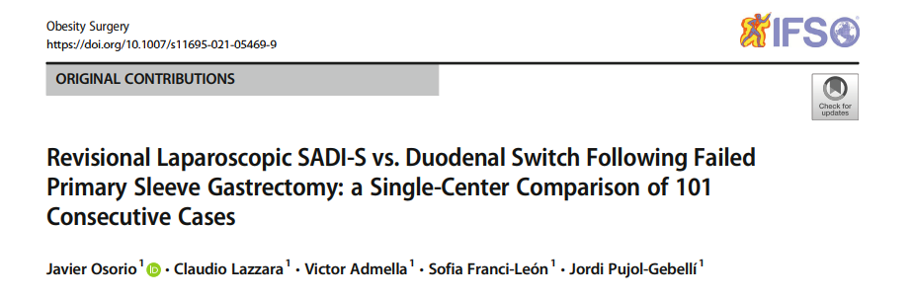

Slide 6
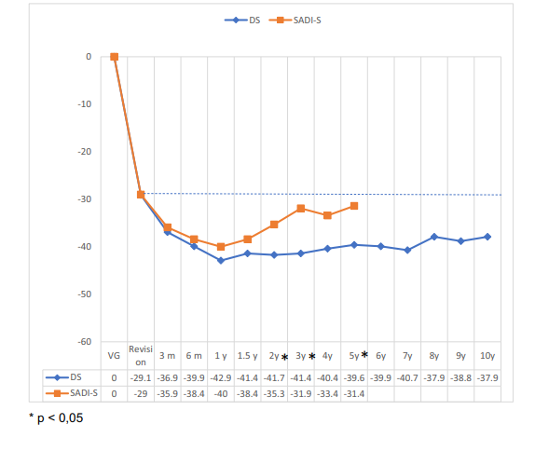
TWL

Slide 7
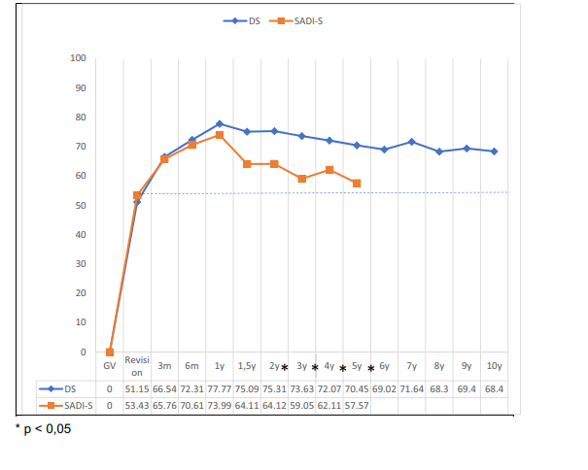
EWL

Slide 8
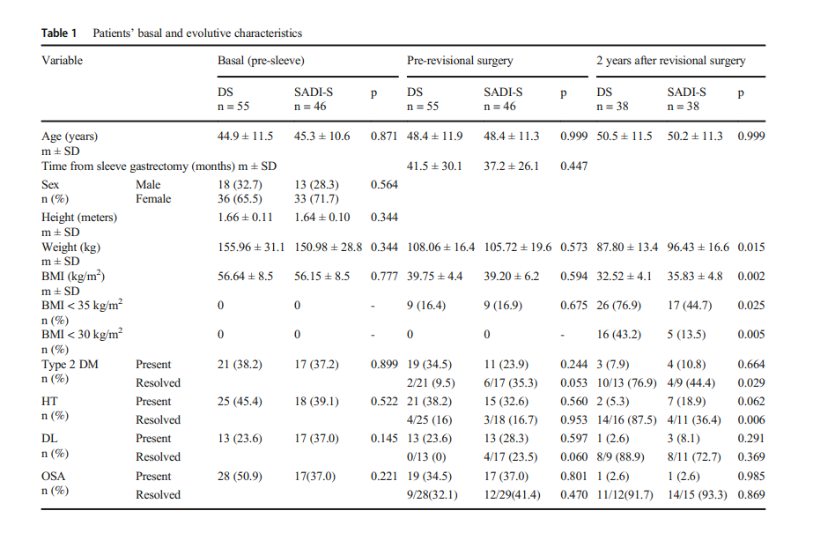

Slide 9
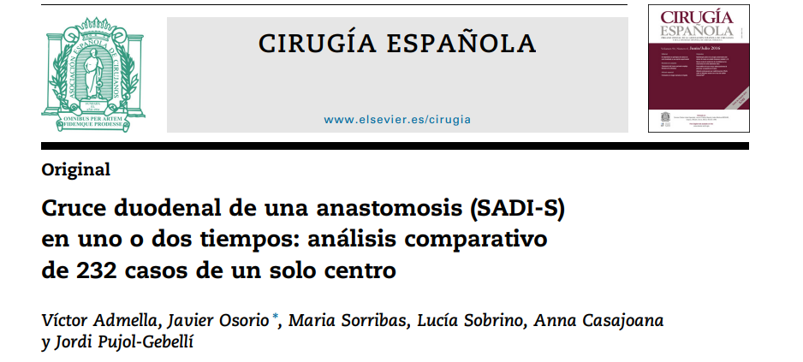

Slide 10
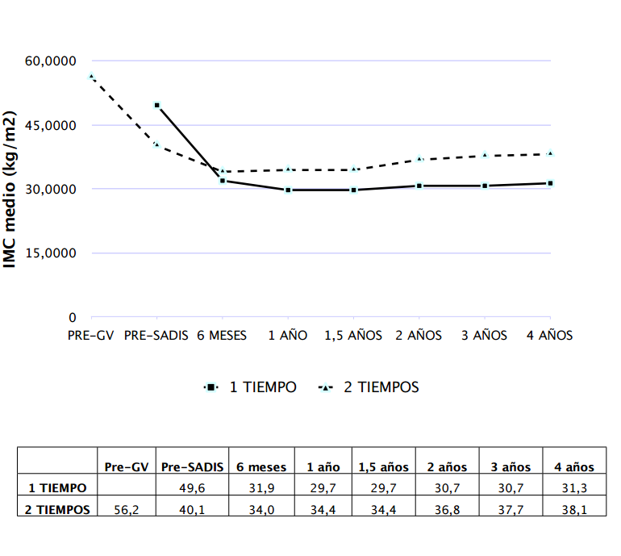
Time from VG to SADIS m (SD): 34,3 [6.2-107.1]

Slide 11
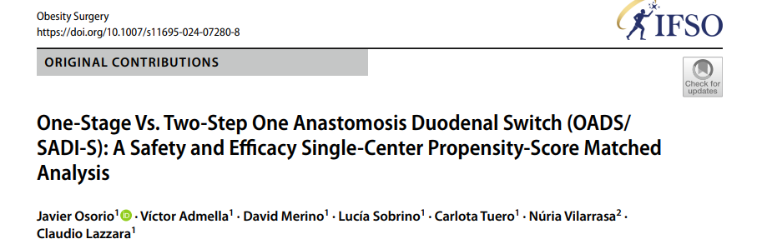

Slide 12
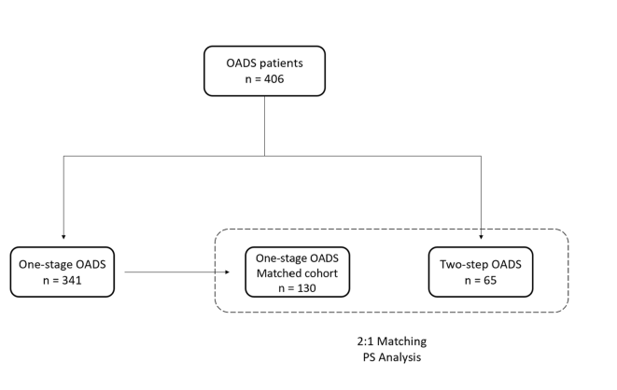

Slide 13
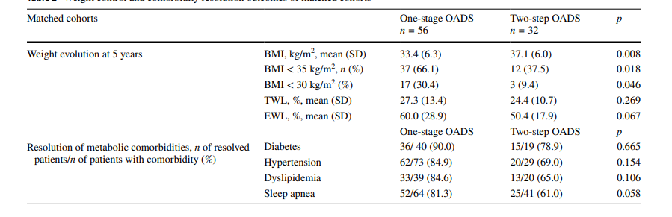

Slide 14
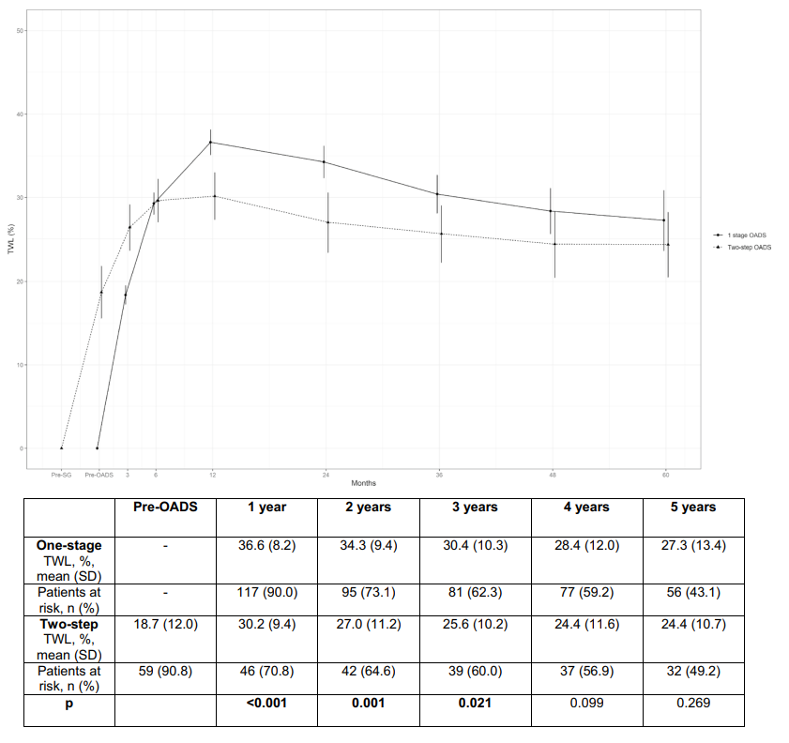

Slide 15
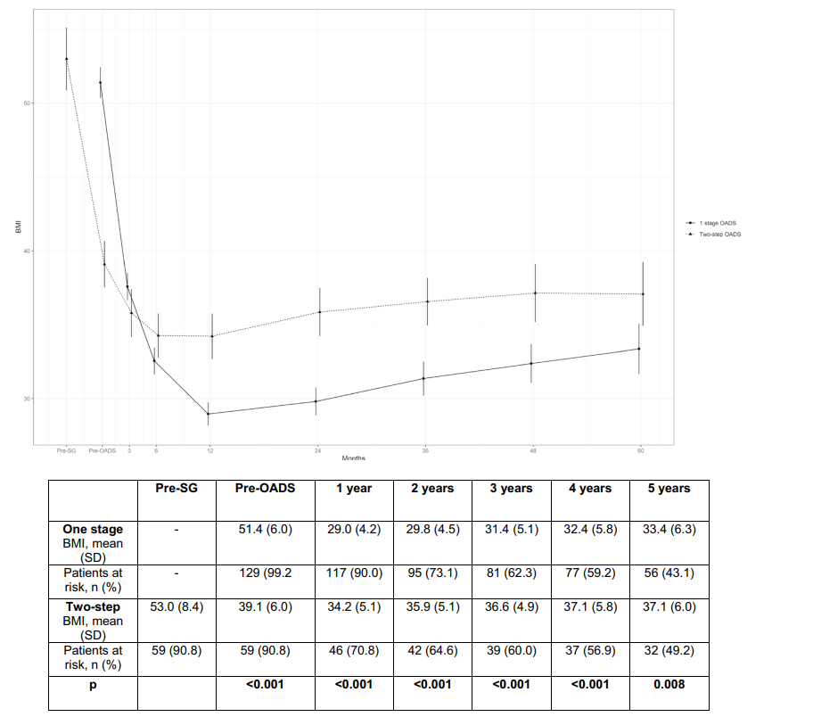

Slide 16
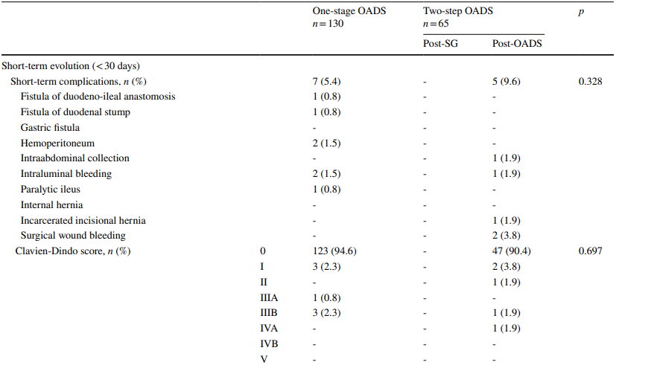

Slide 17
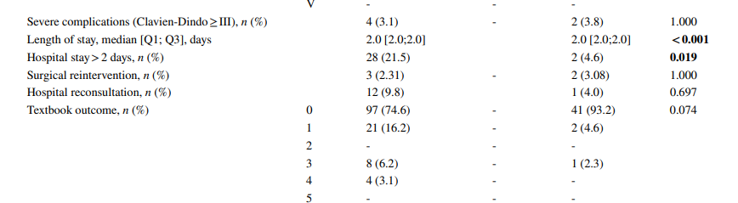

Slide 18
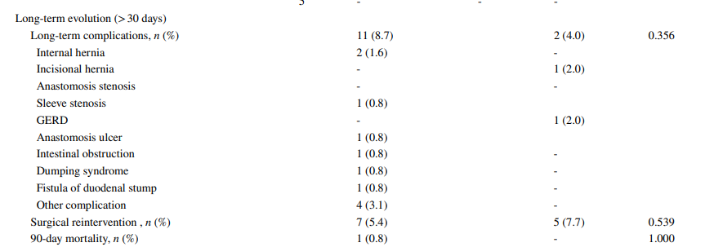

Slide 19
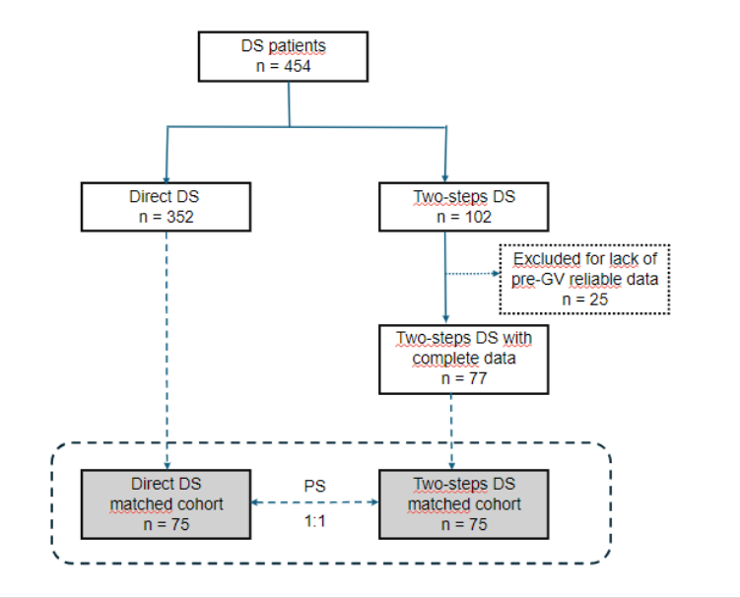
Time free from obesity and metabolic diseases after one-step vs. two-step duodenal switch: a propensity-score single-center analysis

Slide 20
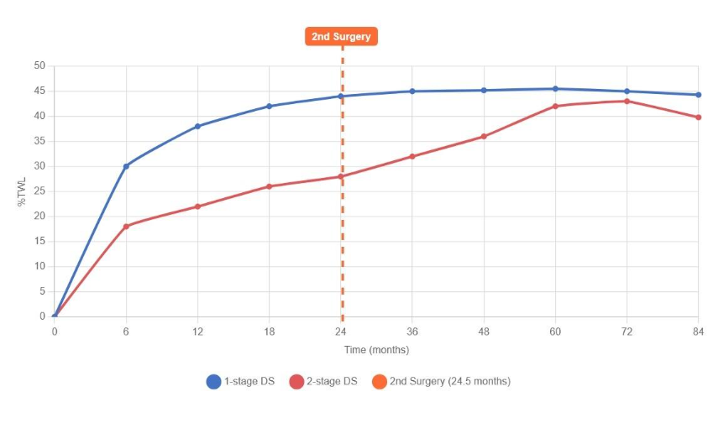
Time free from obesity and metabolic diseases after one-step vs. two-step duodenal switch: a propensity-score single-center analysis

Slide 21
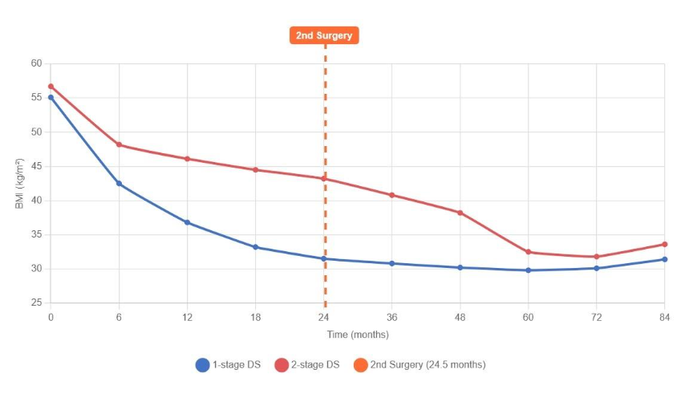
Time free from obesity and metabolic diseases after one-step vs. two-step duodenal switch: a propensity-score single-center analysis

Slide 22
SADI-S AS A 2-STEP OR REVISIONAL TECHNIQUE
- Safe: simmilar morbidity than primary
- Less effective than DS: 300 cm common limb in patients with maximum BMI > 55 kg/m2 and time since sleeve gastrectomy > 1 year
- Less effective than one-step: time free from obesity

Slide 23
REVISIONAL SURGERY INDICATION
Sleeve Gastrectomy
Insufficient weight loss / weight regain

Slide 24
REVISIONAL SURGERY INDICATION
Sleeve Gastrectomy
Insufficient weight loss / weight regain
Maximum BMI < 50 kg/m²
BMI 50-55 kg/m²
Maximum BMI > 55 kg/m²
< 1 year after Sleeve
< 50 years old
Non- diabetic
Poor compliance
> 1 year after Sleeve
> 50 years old
Diabetic
Good compliance
SADI-S
300 cm
Duodenal Switch
Or SADI-S 250 cm

Slide 25
REVISIONAL SURGERY INDICATION
Sleeve Gastrectomy
Insufficient weight loss / weight regain
GERD
Maximum BMI < 50 kg/m²
BMI 50-55 kg/m²
Maximum BMI > 55 kg/m²
< 1 year after Sleeve
< 50 years old
Non- diabetic
Poor compliance
> 1 year after Sleeve
> 50 years old
Diabetic
Good compliance
Gastric Bypass
SADI-S
300 cm
Duodenal Switch
Or SADI-S 250 cm

Slide 26
REVISIONAL SURGERY INDICATION
Sleeve Gastrectomy
Insufficient weight loss / weight regain
GERD
Maximum BMI < 50 kg/m²
BMI 50-55 kg/m²
Maximum BMI > 55 kg/m²
< 1 year after Sleeve
< 50 years old
Non- diabetic
Poor compliance
> 1 year after Sleeve
> 50 years old
Diabetic
Good compliance
Gastric Bypass
SADI-S
300 cm
Duodenal Switch
Or SADI-S 250 cm
Biliary reflux
Insufficient weight loss / weight regain

Slide 27
One-Stage vs. Two-Step One Anastomosis Duodenal Switch (OADS/SADI-S)
Javier Osorio, MD, PhD
30th October 2025
Notes:
Buenos días, compañeros. En la sesión de hoy queremos hablaros de la cirugía bariátrica hipoabsortiva primaria .

